Slide 1
Module 8: Portfolio Project
Nitin Tambe
Colorado State University Global
MIS581: Capstone - Business Intelligence and Data Analytics
Dr. Justin Bateh
04/10/2022

Slide 2
Table of contents
Introduction – OPIOID Addiction
Objective and Overview of study
Research Hypothesis
Literature Review
Research Design
Ethical Considerations
Regression Results R and SAS Enterprise Miner
Recommendations
References

Slide 3
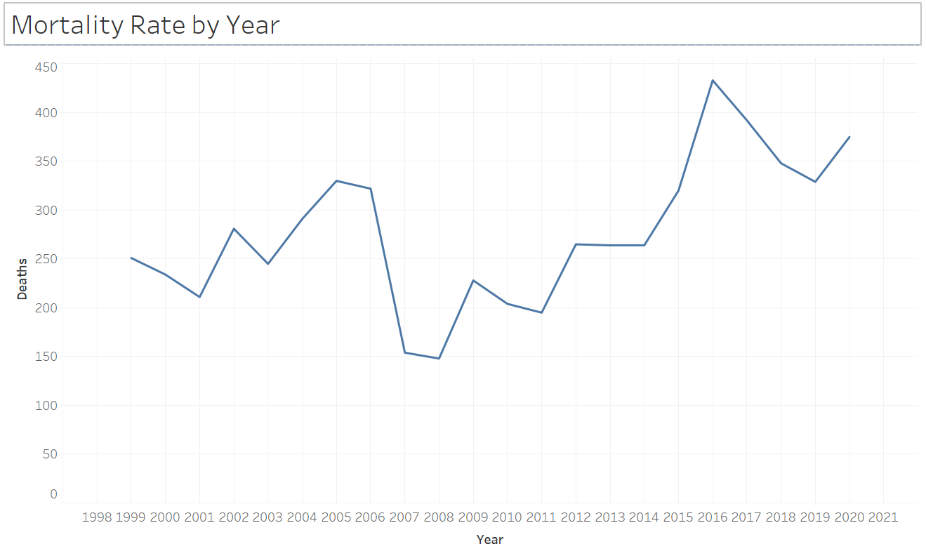
Introduction – OPIOID Addiction
Opioid - Used as a pain killer, lot of side effects with risks of addiction
As per CDC - Almost 130 Americans die every day
Since 1999, out of 841, 000 deaths 70% related to Opioid overdose
Between 1999 and 2016, approximately 9,000 American children died (Gaither et al. 2018)
Children aged 12 to 17 misused opioids estimated number is 769,000
Figure 1
Mortality Rates due to OPIOID overdose
Note: Created from the CDC – WONDER data
Notes:
The first slide after the title slide should introduce the audience to the structure of the presentation. Consider it a short outline of your presentation. Speaker notes for this slide might include an introduction to your topic and a thesis statement or summary of your argument.

Slide 4
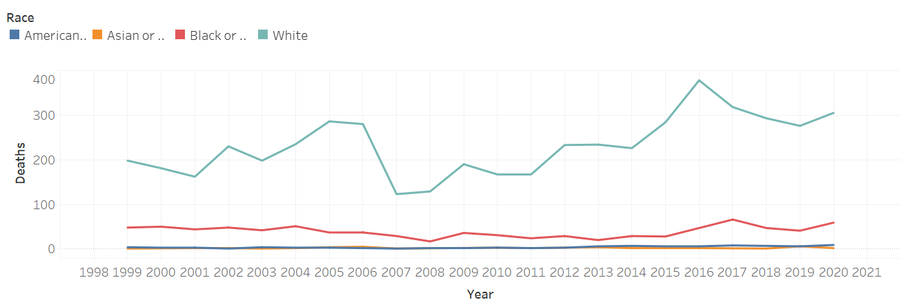
Objective and overview of study
Trends related to opioid use
Relationship between the gender, race
Data gathered from the WONDER website provided by CDC
Mortality rate related to opioid ICD codes from 1990 to 2020.
Figure 2
Mortality Rates due to OPIOID overdose – Display Race
Notes:
Speaker notes should expand on the content in the slide. Minimize the amount of content on the slide to make it readable and visually appealing. When supporting your claims with evidence, use in-text citations as necessary. For example:
In contrast, minority nations and indigenous peoples push back against anti-environmentalist nationalism. Indigenous groups reiterate their sovereignty and ownership of the land when protesting the extraction of fossil fuels or natural gas, like with the Dakota Access Pipeline. The Standing Rock Sioux Tribe sued to end construction of the pipeline, arguing that an oil spill would pose a substantial threat to their water (Friedman, 2020). In these cases, indigenous peoples oppose governments that have long denied or minimized indigenous rights and sovereignty--the same governments that wield nationalist rhetoric in an effort to promote harmful environmental policies. In an effort to prevent further environmental degradation, indigenous peoples and other marginalized groups work collectively to promote public policy and mitigate climate change, which disproportionately impacts minorities and the global south.

Slide 5
RESEARCH HYPOTHESIS
How mortality has changed over a period of time
H₀ – Mortality counts are same over a period of time. The numbers are not increasing for opioid related deaths
H_{a} – Mortality counts are NOT same for opioid related deaths over a period of time
How gender affects the mortality rate
H₀ – Mortality count is same for both genders
H_{a} – Mortality count is NOT same for both genders
How race affects mortality rates
H₀ – Mortality counts are same across all races
H_{a} – Mortality counts are NOT same across all races

Slide 6
LITERATURE REVIEW
Food and Drug Administration (FDA) announced a comprehensive review of the agency's opioids policies
CDC has also confirmed to fundamentally re-examine the risk-benefit paradigm for opioids use and to ensure that it has consider wider public health (Furlow, 2016).
As per the (McCarthy, 2016), President Barack Obama had proposed new funding to increase access to treatment for misuse of prescribed opioids which was estimated to be around $1.1bn.
In the 2022, state of the union addresses current president Biden also emphasized on the Opioid crisis.
A more percentage of adolescence girls are now abusing it at a higher rate than their male counterparts. There is high-rate increase in the prevalence of fatal overdose of this drug in women than the men. Women are using it for stress management. ( Chartoff & McHugh 2016).

Slide 7
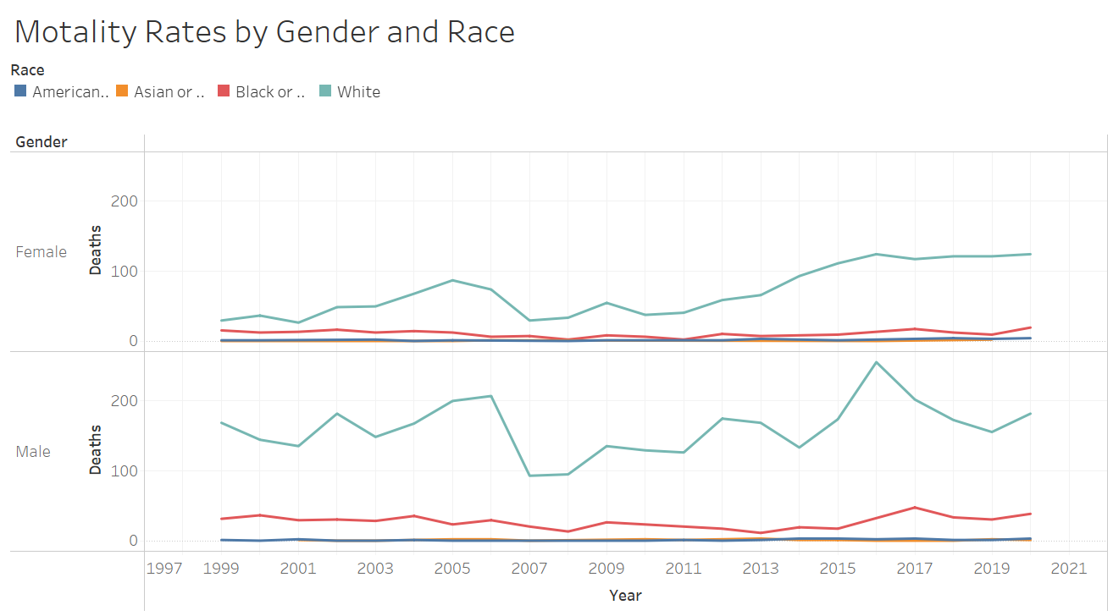
Research design - I
Tableau provides feature which can be easily used for the data visualization. Data visualization can help in identifying the trends in the data which can be further investigated.
Figure 3
Tableau chart - Mortality Rates due to OPIOID overdose – Display Race & Gender

Slide 8
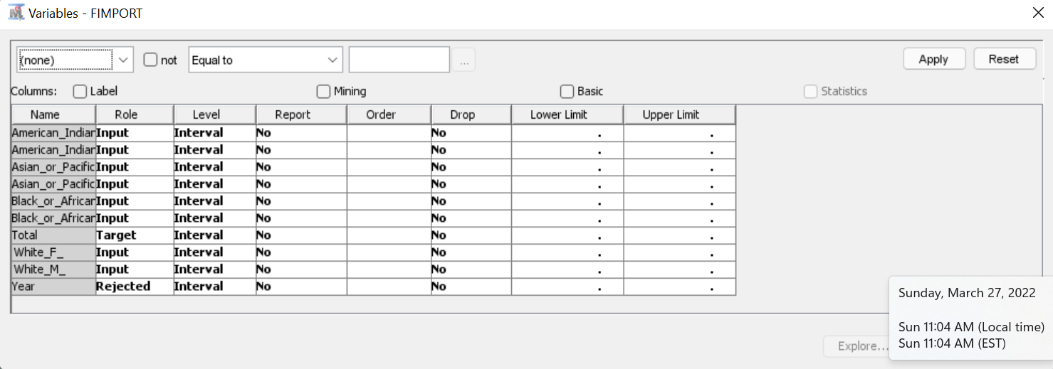
Research design - II
SAS studio offers comprehensive tools to create the data models and visualizations.
Filters are used to remove null values, SatExplore helps in understanding more about the data.
Regression analysis can help identify the p value which can help prove or not prove the hypothesis.
Figure 4
SAS Enterprise Miner

Slide 9
Ethical considerations
The data used for this exercise is available on the CMS – WONDER. The data can be unloaded and used for specific purpose only.
The data used does not include any individual’s private information which can identify specific person. While creating visualizations designer should ensure those are easy to understand and simple.
In visualizations it is easy to manipulate the viewers by incorrect representation of data. It is very important to follow the ethical principles while representing the data. The designers should avoid viewers with misleading graphs or charts.

Slide 10
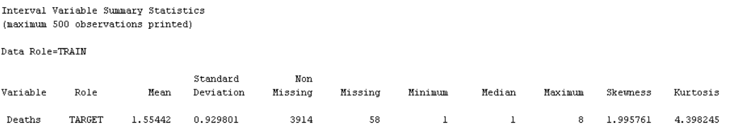
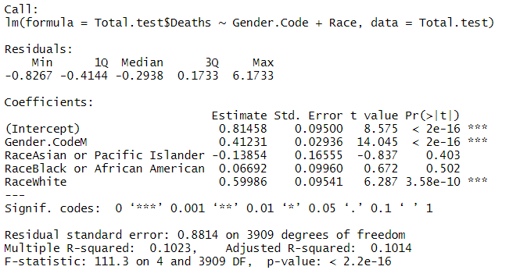
Regression results - R
Figure 5
R output

Slide 11
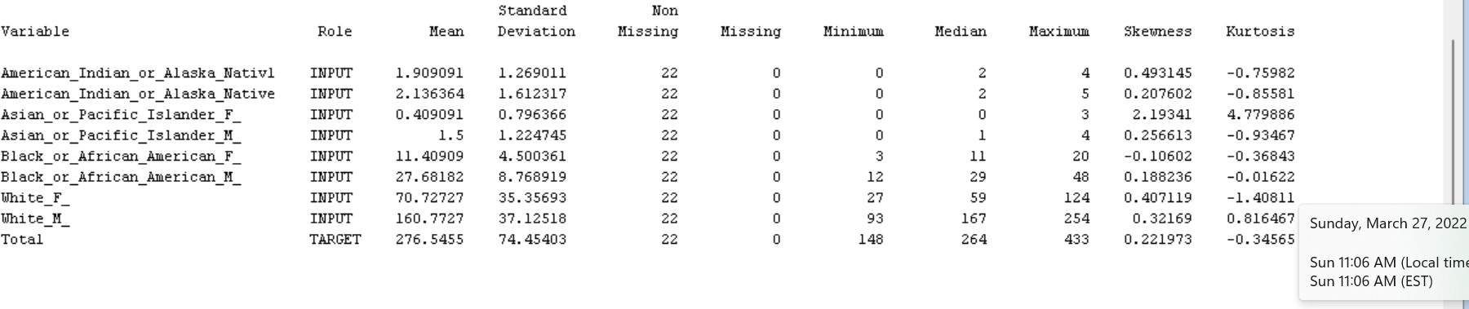
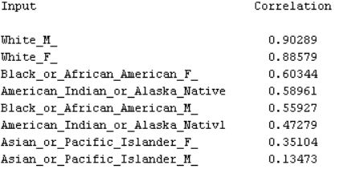
Regression – SAS Enterprise miner
Figure 6
SAS Enterprise Miner - Output

Slide 12
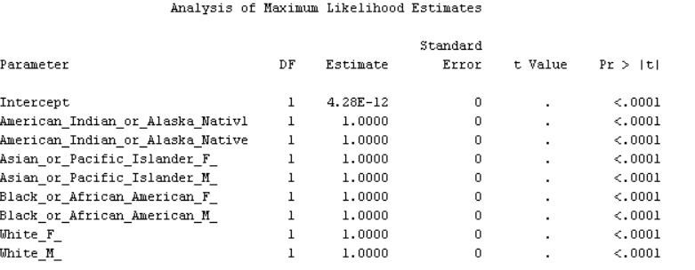
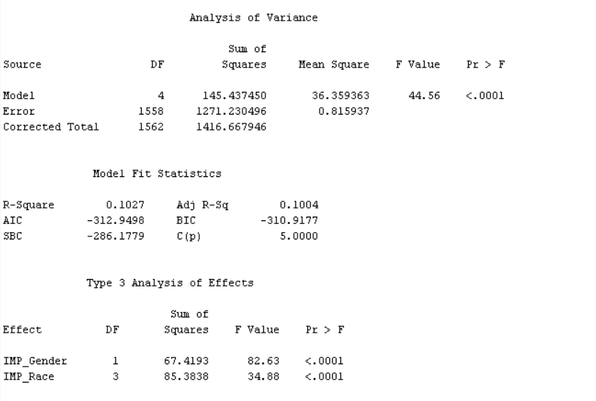
Regression – SAS Enterprise miner - II
The regression analysis clearly show strong significance of Race and Gender in Mortality rates
Figure 7
SAS Enterprise Miner – Output - II

Slide 13
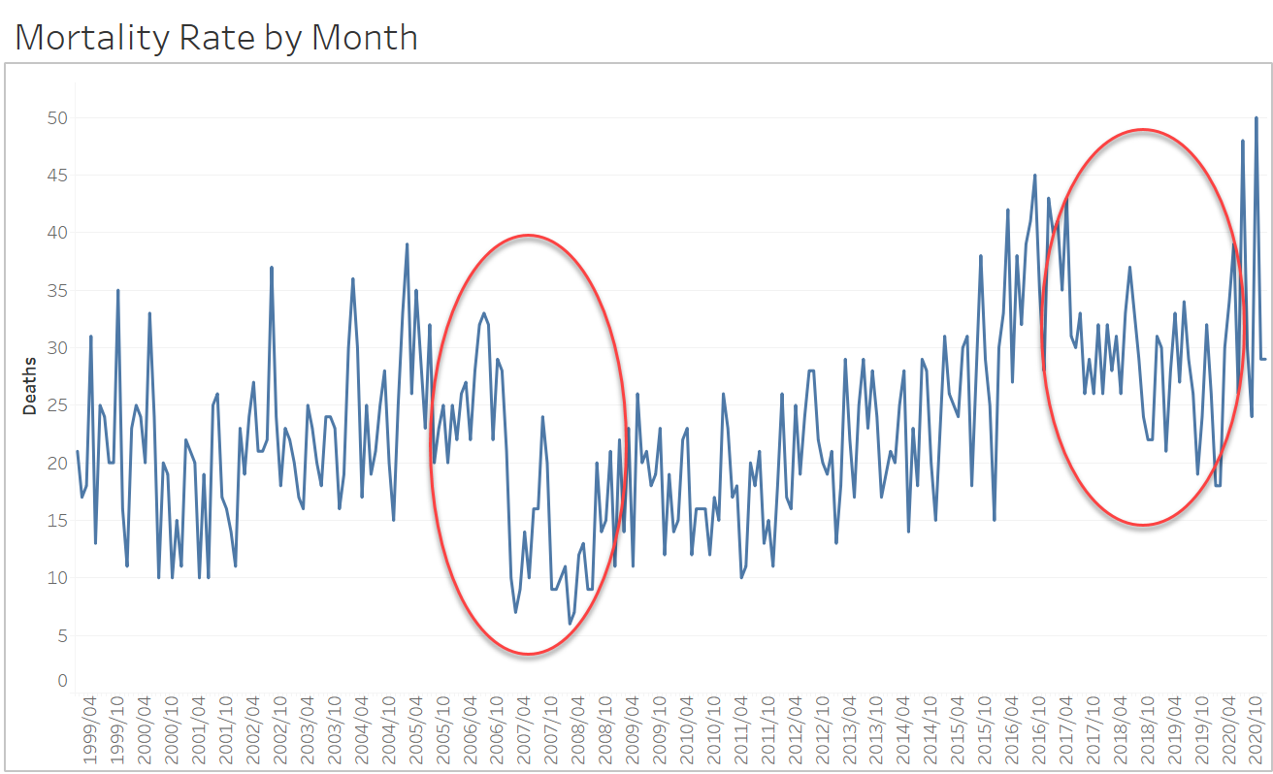
recommendations
Figure 8
Mortality rates by Months
There is increase in counts for the white females. This should be studies further for the identification of the root cause.
It shows there is a decline in the rates before it starts rising again. This should be studies further to identify what causes the reduction in these numbers.

Slide 14
References
Biden Administration Set To Release Plan For Treating Opioid Addiction. (2021). Morning Edition.
Blair, K. (2020, Jan 28). Measuring the Impact of Opioid Crisis Management. Retrieved from Express Scripts: https://express-scripts.com/corporate/index.php/articles/measuring-impact-opioid-crisis-management
Chartoff, E. H., & McHugh, R. K. (2016). Translational Studies of Sex Differences in Sensitivity to Opioid Addiction. Neuropsychopharmacology : Official Publication of the American College of Neuropsychopharmacology, 41(1), 383–384. https://doi.org/10.1038/npp.2015.272
Furlow, B. (2016). FDA confronts opioid addiction and overdose deaths. The Lancet. Oncology, 17(3), e95. https://doi.org/10.1016/S1470-2045(16)00090-5
Gaither, J. R., Shabanova, V., & Leventhal, J. M. (2018). US National Trends in Pediatric Deaths from Prescription and Illicit Opioids, 1999-2016. JAMA Network Open, 1(8), e186558. https://doi.org/10.1001/jamanetworkopen.2018.6558
intellipaat. (2022, Jan 08). What is Tableau? Retrieved from intellipaat: https://intellipaat.com/blog/what-is-tableau/
Kirvan, P. (2021, Jan 6). 20 keys to a successful enterprise data protection strategy. Retrieved from techtarget: https://www.techtarget.com/searchdatabackup/tip/20-keys-to-a-successful-enterprise-data-protection-strategy
Lee, W. W., Zankl, W., & Chang, H. (2016, Dec 24). An Ethical Approach to Data Privacy Protection. Retrieved from ISACA JOURNAL: https://www.isaca.org/resources/isaca-journal/issues/2016/volume-6/an-ethical-approach-to-data-privacy-protection

Slide 15
References
McCarthy, M. (2016). US needs $1.1bn to treat opioid addiction. BMJ (Clinical Research Ed.), 352, i694. https://doi.org/10.1136/bmj.i694
mergr. (n.d.). Cigna Acquires Express Scripts Holding. Retrieved from mergr: https://mergr.com/cigna-acquires-express-scripts-holding#:~:text=On%20March%208%2C%202018%2C%20Cigna%20Corp.%20acquired%20healthcare,sector.%20This%20is%20Cigna%E2%80%99s%201st%20largest%20%28disclosed%29%20transaction.
NIDA. (2021, March 11). Opioid Overdose Crisis. Retrieved from National Institute of Drug Abuse: https://nida.nih.gov/drug-topics/opioids/opioid-overdose-crisis
PCMA. (2022). Pharmacy Benefit Managers (PBMs) Provide Solutions to Address the Opioid Crisis. Retrieved from Drug Benefit Solutions: https://drugbenefitsolutions.com/drug-policy/pbm-solutions-to-address-opioid-crisis/
SAS. (2022). SAS. Retrieved from SAS Enterprise Miner™ Features: https://www.sas.com/en_us/software/enterprise-miner/features-list.html

